Slide 1


Vivekanand Education Society’s Institute of Technology, Computer Department
Human Team Foundation
Team details
Team Name: CodeOverflow
Team Member: Bhavesh Lohana

Slide 2
Abstract
For this problem, I have decided to user the minimalist approach. As its an NGO website, it would be better to not clutter it with many technologies and use with the reliable ones. Further, to increase the reach, effective SEO would be used. The website would strictly revolve around the chief aim of the Human Team Foundation. And, an admin page for the ease of adding and editing the events articles quickly.

Slide 3
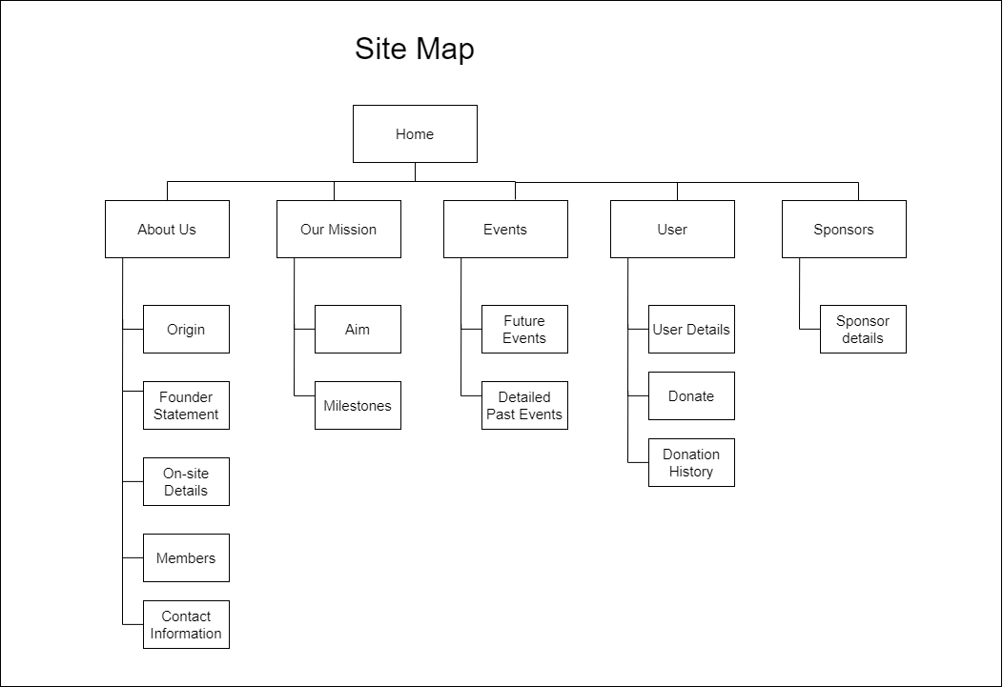
Proposed Architecture
(Diagram/Example/Flowchart/Etc)
User account is optional so as to make the donation process quicker.
The perks of having user account would be to keep the transaction history seamless.

Slide 4
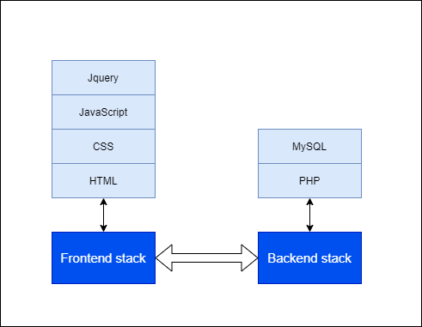
Technology Stack
LAMP STACK

Slide 5
Conclusion
The end result will be a website which lets everything transparent between the foundation and its user. The events, sponsors page, user details, transaction will be readily available to both the user and the foundation. The website would be much faster using LAMP stack.

Slide 6
Github Repository Link
https://github.com/bhaveshlohana/humanteamwebsite

